Slide 1
GitHub Actions for iOS Projects
Presented by Pran Kishore
Content Courtesy Arpita Dutta

Slide 2
Why GitHub Actions
Assuming you have an open-source project / project hosted on GitHub and you have multiple contributors.
Wouldn’t it be nice if someone / something checked that you project is still building correctly, and you are still able to deploy your project. E.g., can generate xcframework / IPA file
And if it were free for open source.
Meet GitHub actions

Slide 3
Background
GitHub Actions a CI / CD platform to automate build test and deployment of software.
Based on the concept of workflows. Workflows are a list of jobs where every job has a defined list of steps. Features: 1. Configurable: jobs can be run in parallel or have dependency between them. Steps can run scripts or pre-defined actions from GitHub marketplace.
2. Run a workflow on variety of events like push, pr etc.
3. Runners with different platform support. i.e., macOS, ubuntu, Windows
4. Live logs
5. Built in secret store
6. Free for open source / Cheap

Slide 4
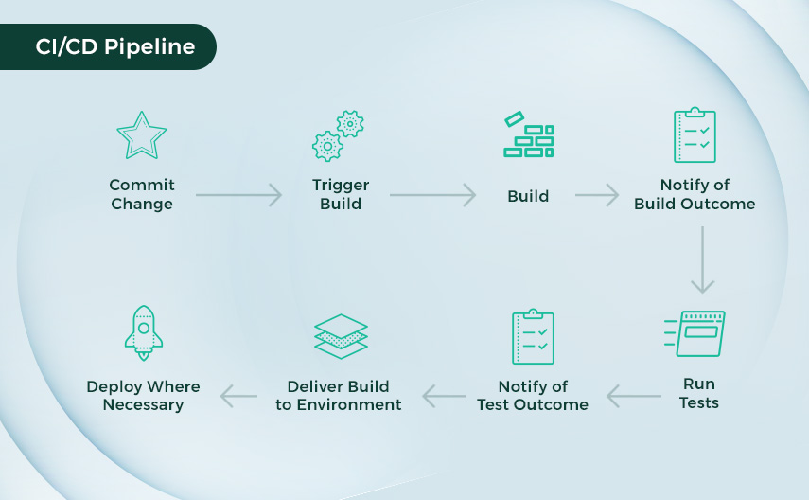

Slide 5

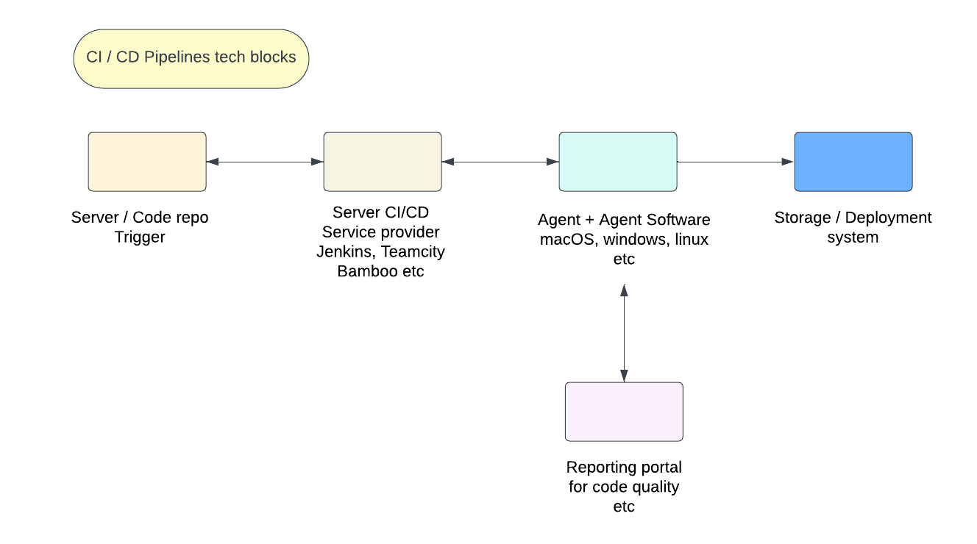
Overview of CI / CD Tech blocks

Slide 6
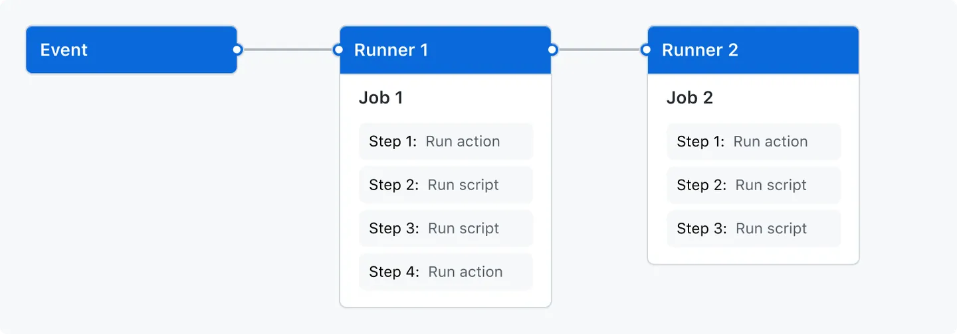
Overview of events runners and Jobs

Slide 7
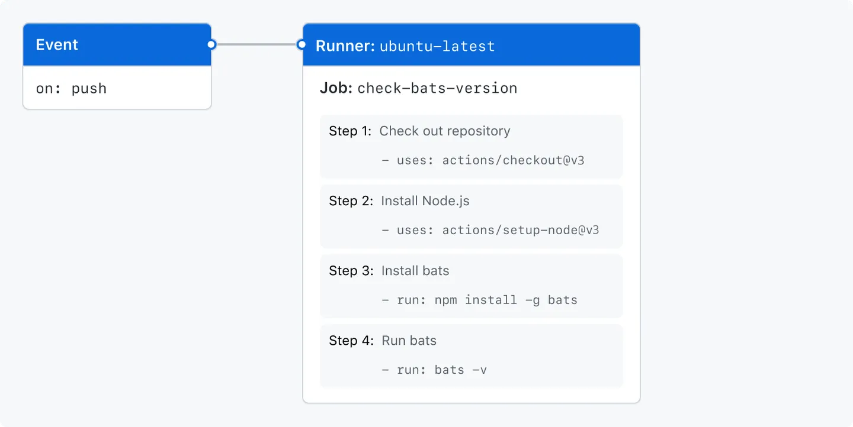
Overview of Jobs and steps
Building blocks are jobs and steps

Slide 8
CI / CD Main steps
﻿﻿﻿Checkout the code
﻿﻿﻿Compile, Unit test, swift lint.
Code Sign, Generate IPA
Upload to Apple

Slide 9
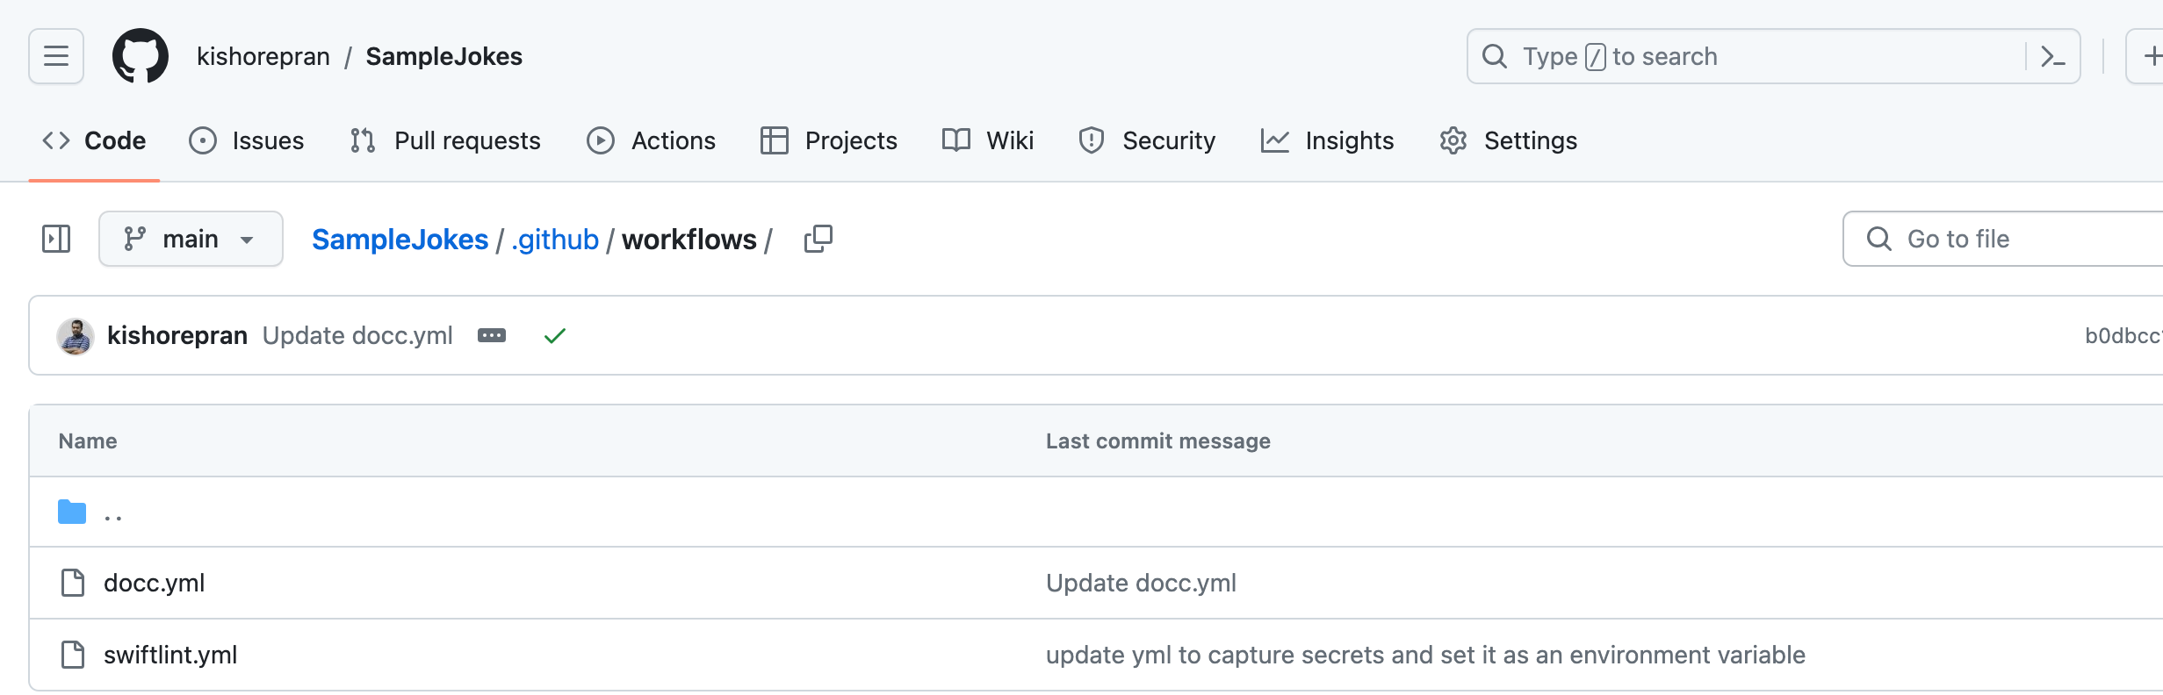
Git hub actions Defined in yml files

Slide 10
Tips for YML file
Indentation spaces colons matter.
Sometimes it’s hard to check if syntax failed.
Validate syntax first using yml validator.

Slide 11
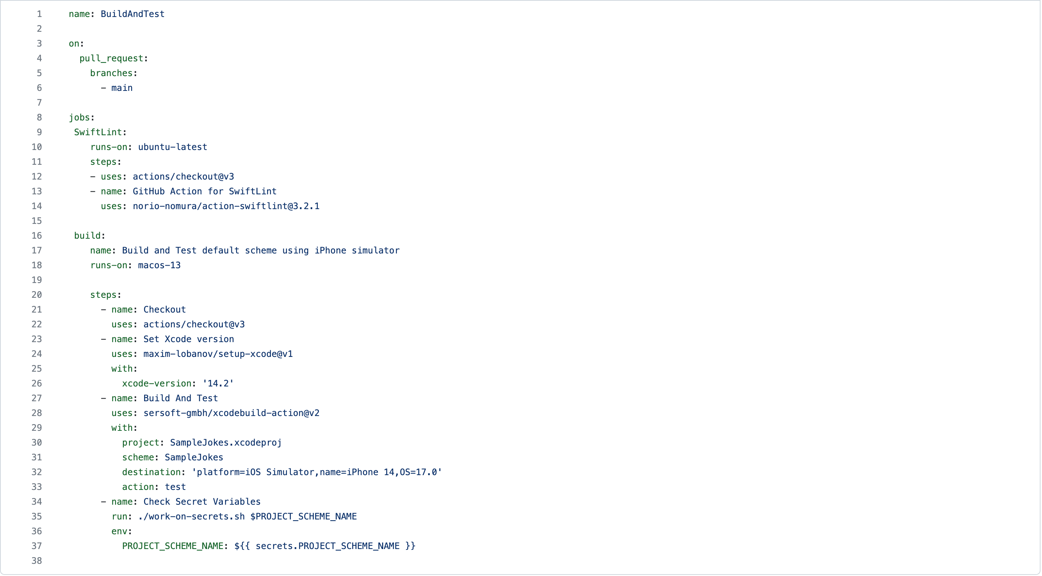

Slide 12
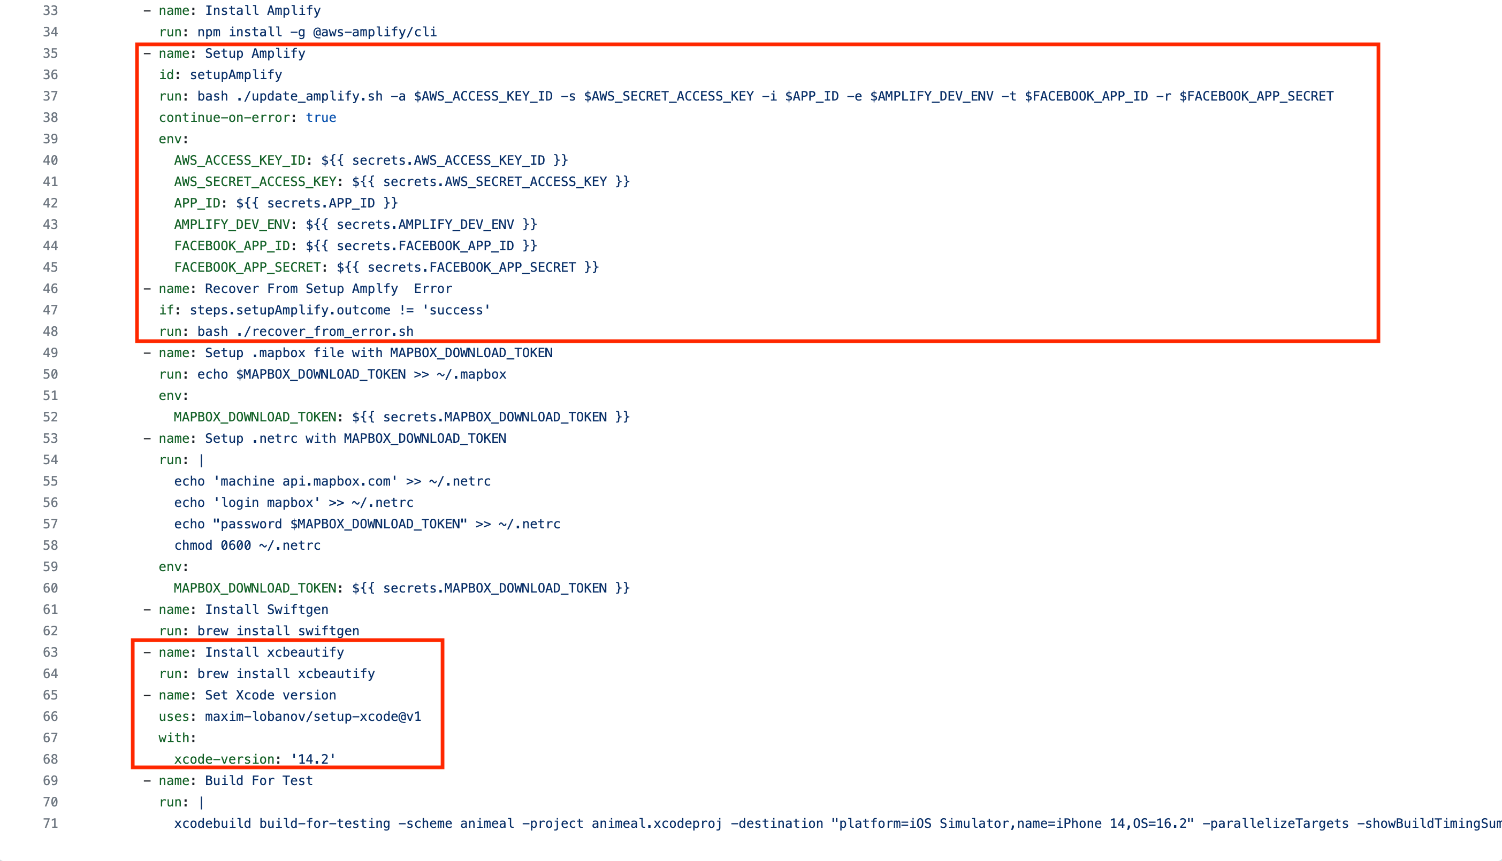

Slide 13
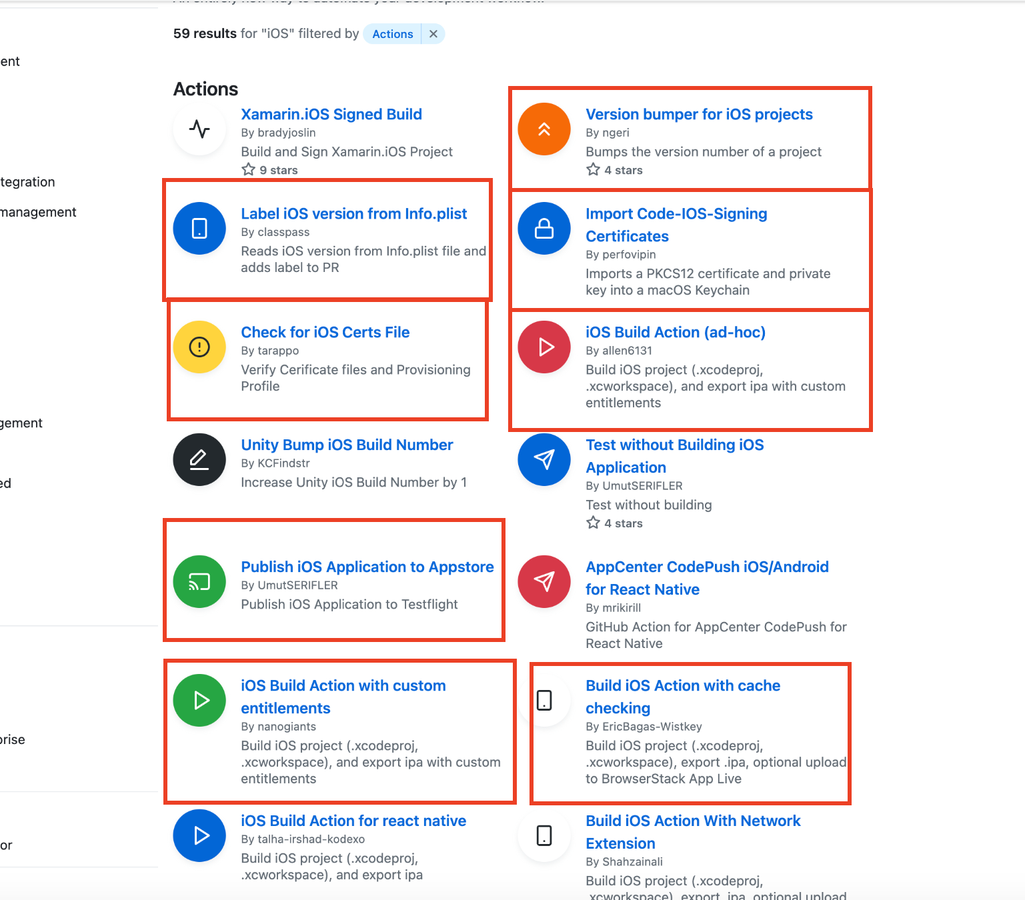
Git hub actions Marketplace
Prebuild scripts works like magic.
Easy to use
In case of issues need to go back to custom scripts

Slide 14
Secret Store
Allows storing of string-based data of max 64kb
Stored encrypted with a key stored with Github.
Store a base64 encoded file as a string
In workflow YML file catch the secret and promote it as environment variable.

Slide 15
Why do we need secrets? API keys to be passed into the project Via command line. Where to locate? Locate in GitHub in repo settings > Secrets and Variables How does this help? Let's just say it OBFUSCATES the logs with lots of stars ***.

Slide 16
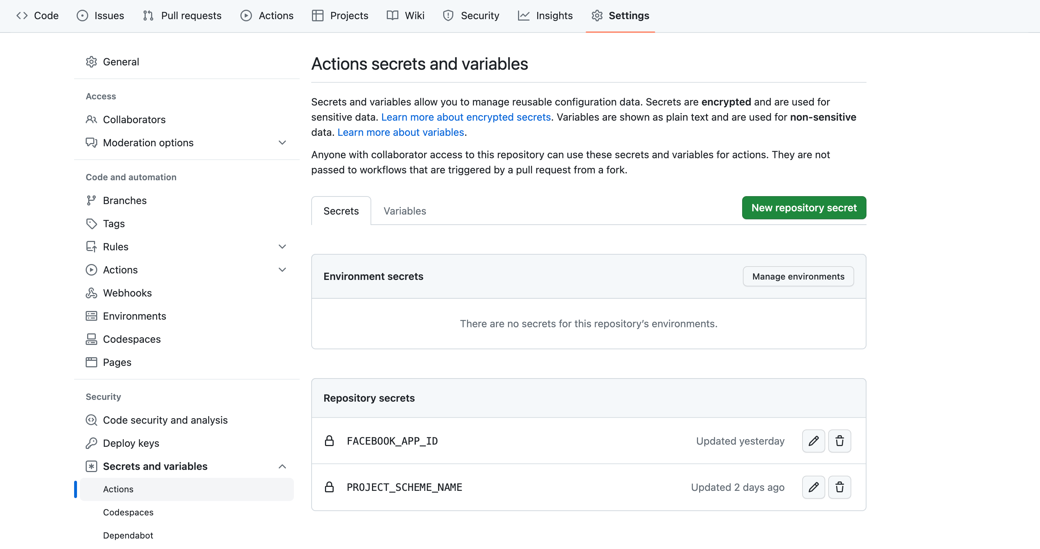

Slide 17
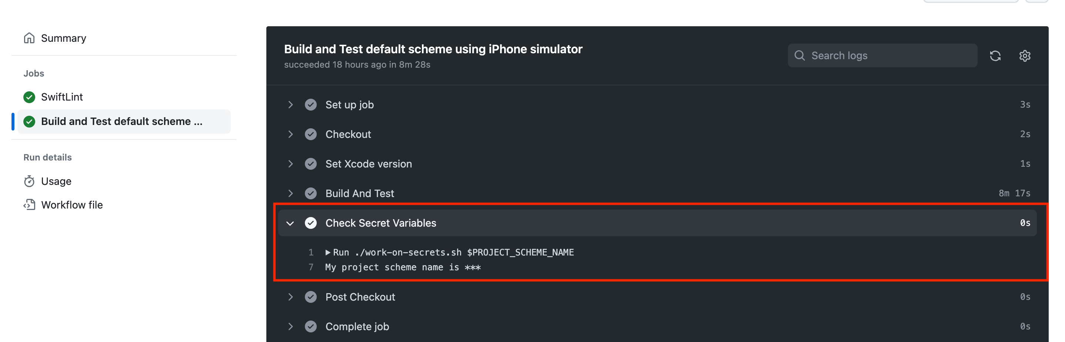
Why a USING A SECRET VIA A script? It hides the ACTUAL PLAIN TEXT AND OBFUSCATES THE LOGS WITH LOTS OF STARS ***.

Slide 18
Demo
Showing location of workflow files
Walkthrough of a sample GitHub action YML file
Generation of docc file and it’s deployment to GitHub pages
Raising a pr and show a GitHub action run

Slide 19
Useful Links
https://docs.github.com/en/actions
https://www.kodeco.com/40047657-docc-tutorial-for-swift-automating-publishing-with-github-actions
https://www.kodeco.com/40047657-docc-tutorial-for-swift-automating-publishing-with-github-actions

Slide 20
Questions

Slide 21
Thank you

